Slide 1
Chapter Three: Register Transfer and Microoperations
Contents to be covered
•Register Transfer Language
•Register Transfer
•Bus and Memory Transfers
•Arithmetic Microoperations
•Logic Microoperations
•Shift Microoperations

Slide 2
3-1 Register Transfer Language (RTL)
Simple digital Systems are an interconnection of hardware modules that do a certain task on the information.
The modules are constructed from such digital components as registers, decoders, arithmetic elements and control logic
Modules are interconnected with common data and control paths to form a digital computer system

Slide 3
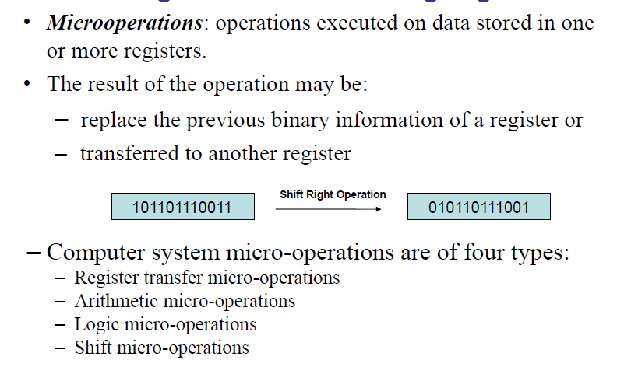
3-1 Register Transfer Language cont.

Slide 4
3-1 Register Transfer Language cont.
The internal hardware organization of a digital computer is defined by specifying:
The set of registers it contains and their function
The sequence of microoperations performed on the binary information stored in the registers
The control that initiates the sequence of microoperations
Register Transfer Language (RTL) : a symbolic notation to describe the microoperation transfers among registers.

Slide 5
3-2 Register Transfer (our first microoperation)
Computer registers are designated by capital letters (sometimes followed by numerals) to denote the function of the register
R1: processor register
MAR: Memory Address Register (holds an address for a memory unit)
PC: Program Counter
IR: Instruction Register
SR: Status Register

Slide 6
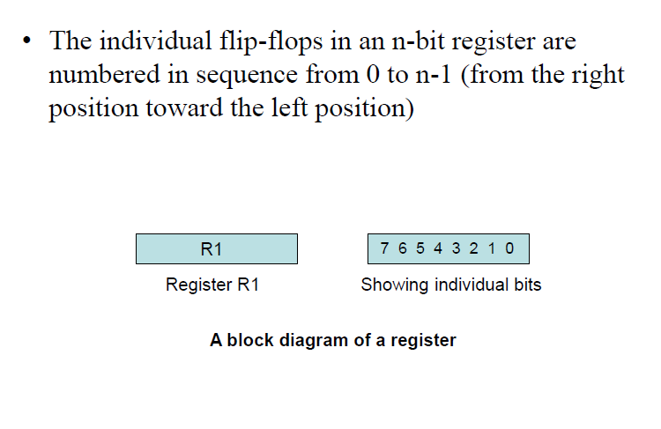
3-2 Register Transfer cont.

Slide 7
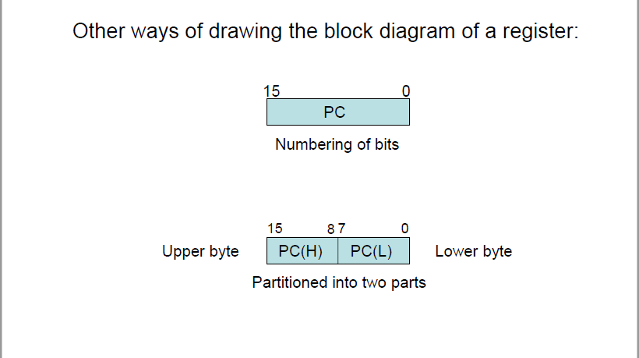
3-2 Register Transfer cont.

Slide 8
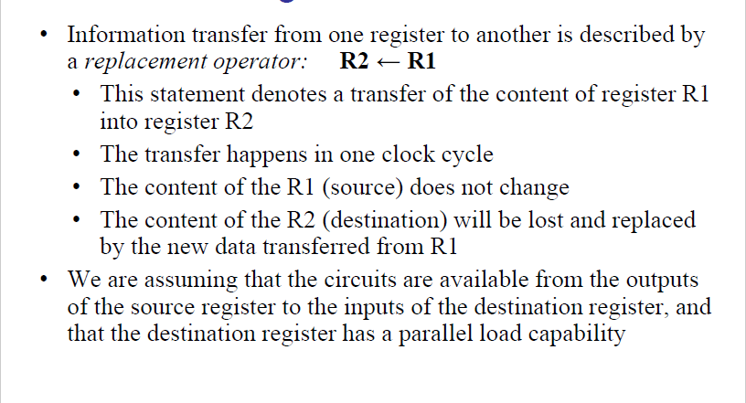
3-2 Register Transfer cont.

Slide 9
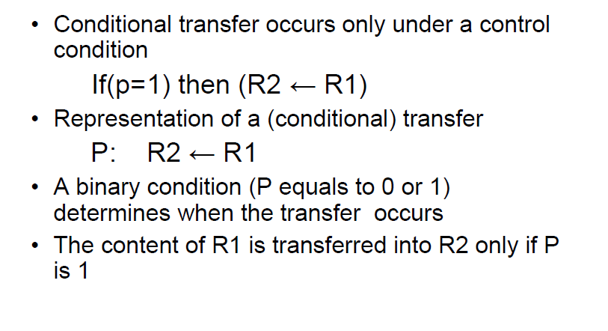
3-2 Register Transfer cont.

Slide 10
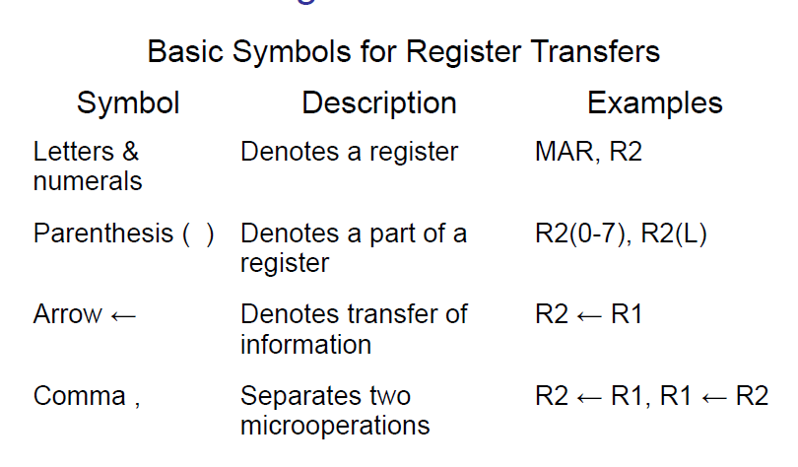
3-2 Register Transfer cont.

Slide 11
3-3 Bus and Memory Transfers
Paths must be provided to transfer information from one register to another
A Common Bus System is a scheme for transferring information between registers in a multiple-register configuration
A bus: set of common lines, one for each bit of a register, through which binary information is transferred one at a time
Control signals determine which register is selected by the bus during each particular register transfer

Slide 12
3-3 Bus and Memory Transfers

Slide 13
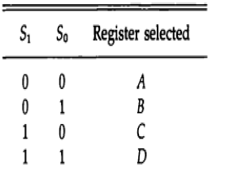
3-3 Bus and Memory Transfers
The selection lines choose the four bits of one register and transfer them in to the four line common bus.

Slide 14
3-3 Bus and Memory Transfers
The transfer of information from a bus into one of many destination registers is done:
By connecting the bus lines to the inputs of all destination registers and then:
activating the load control of the particular destination register selected
We write: R2 ← C to symbolize that the content of register C is loaded into the register R2 using the common system bus
It is equivalent to: BUS ←C, (select C)
R2 ←BUS (Load R2)

Slide 15
3-3 Bus and Memory Transfers
A memory unit is a collection of storage cells together with associated circuits needed to transfer information in and out of storage.
The memory stores binary information in groups of bits called words
Data being read or wrote is called a memory word (called M)
It is necessary to specify the address of M when writing /reading memory
This is done by enclosing the address in square brackets following the letter M
Example: M[0016] : the memory contents at address 0016

Slide 16
3-3 Bus and Memory Transfers:
The transfer of information from a memory word to the outside environment is called a read operation.
Memory read : Transfer from memory
The transfer of new information to be stored into the memory is called a write operation.
Memory write : Transfer to memory
Assume that the address of a memory unit is stored in a register called the Address Register AR
Lets represent a Data Register with DR, then:
Read: DR ← M[AR]
Write: M[AR] ← DR

Slide 17
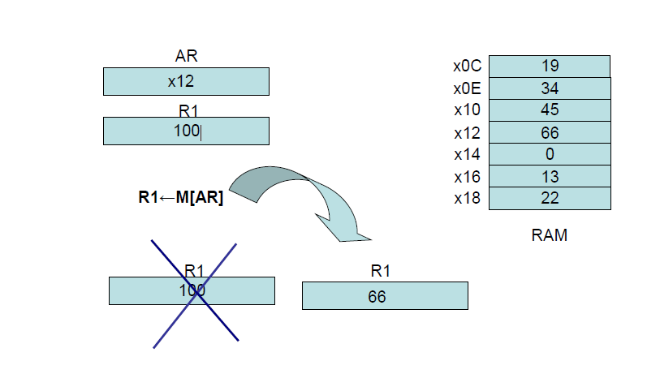
3-3 Bus and Memory Transfers

Slide 18
3-4 Arithmetic Microoperations
The microoperations most often encountered in digital computers are classified into four categories:
–Register transfer microoperations
–Arithmetic microoperations (on numeric data stored in the registers)
–Logic microoperations (bit manipulations on non-numeric data)
–Shift microoperations

Slide 19
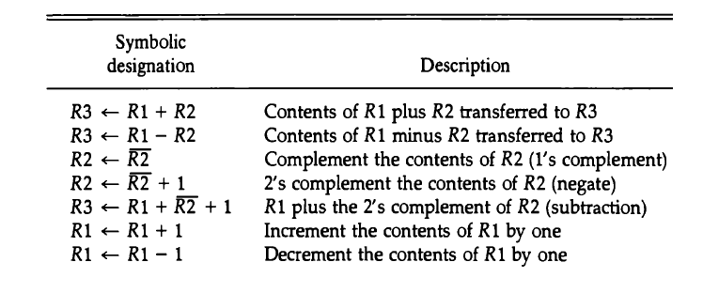
3-4 Arithmetic Microoperations cont.
The basic arithmetic microoperations are: addition, subtraction, increment, decrement, and shift
The following table shows the arithmetic microoperation

Slide 20
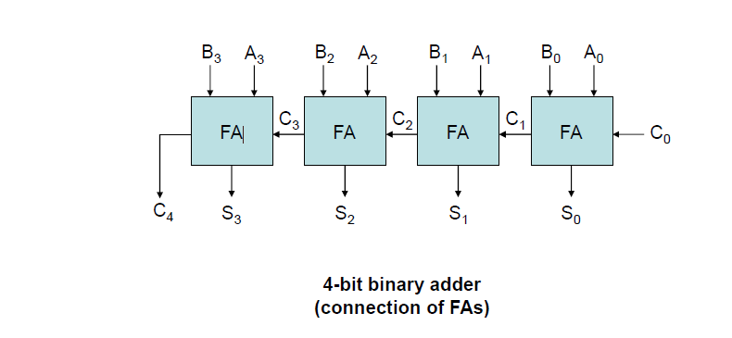
3-4 Arithmetic Microoperations Binary Adder

Slide 21
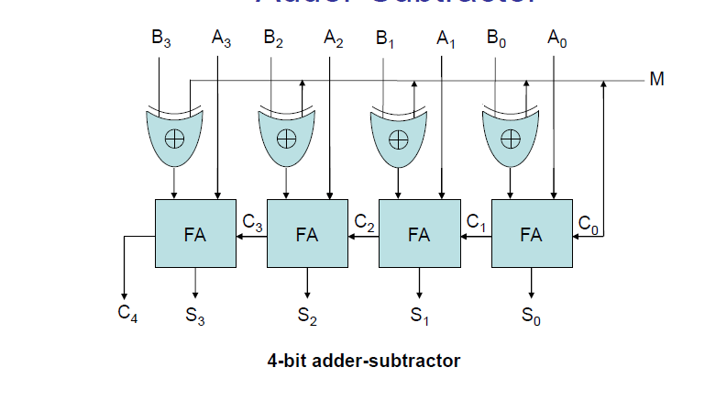
3-4 Arithmetic Microoperations Binary Adder-Subtractor

Slide 22
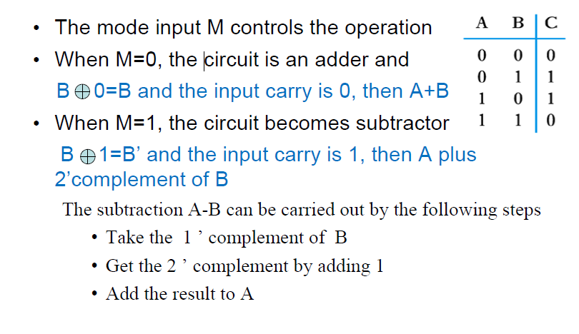
3-4 Arithmetic Microoperations Binary Adder-Subtractor

Slide 23
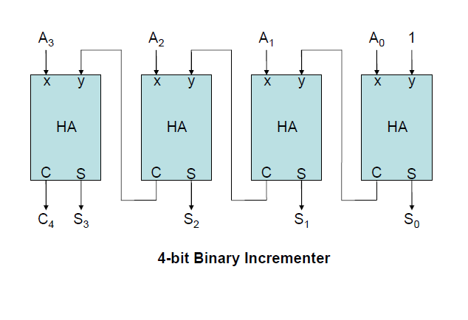
3-4 Arithmetic Microoperations Binary Incrementer

Slide 24
3-4 Arithmetic Microoperations Binary Incrementer
Binary Incrementer can also be implemented using a counter
A binary decrementer can be implemented by adding 1111 to the desired register each time!

Slide 25
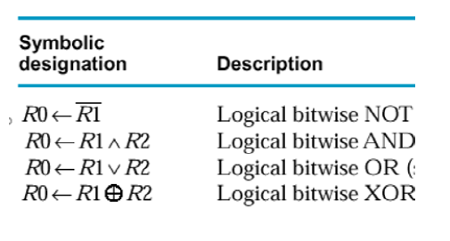
3-5 Logic Microoperations
Manipulating the bits stored in a register (bit by bit)
The four basic logic microoperations

Slide 26
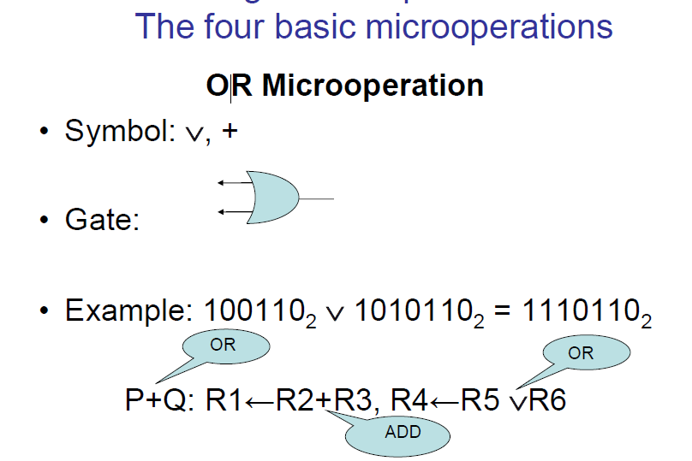
3-5 Logic Microoperations

Slide 27
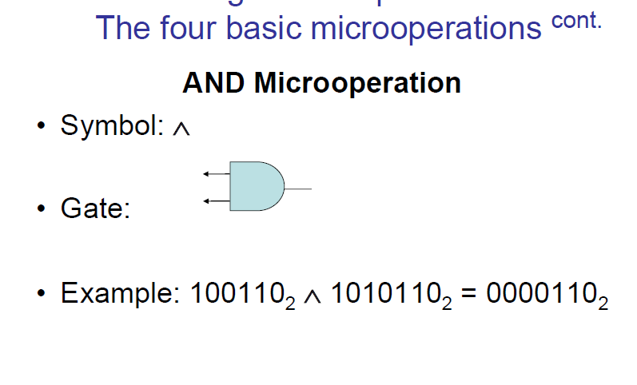
3-5 Logic Microoperations

Slide 28
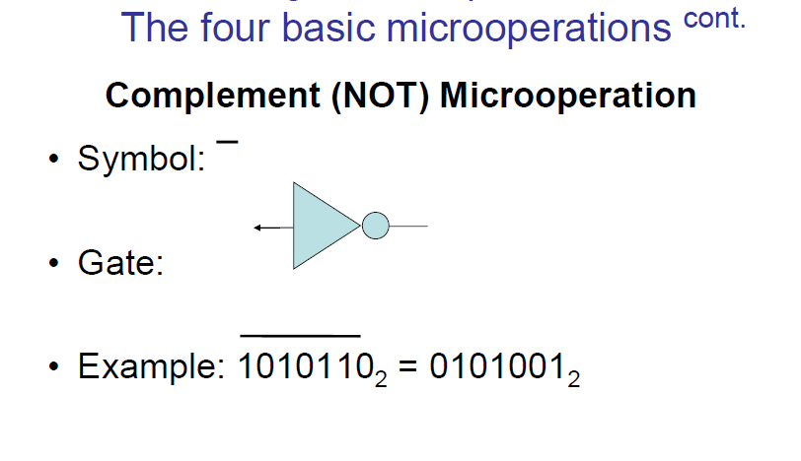
3-5 Logic Microoperations

Slide 29
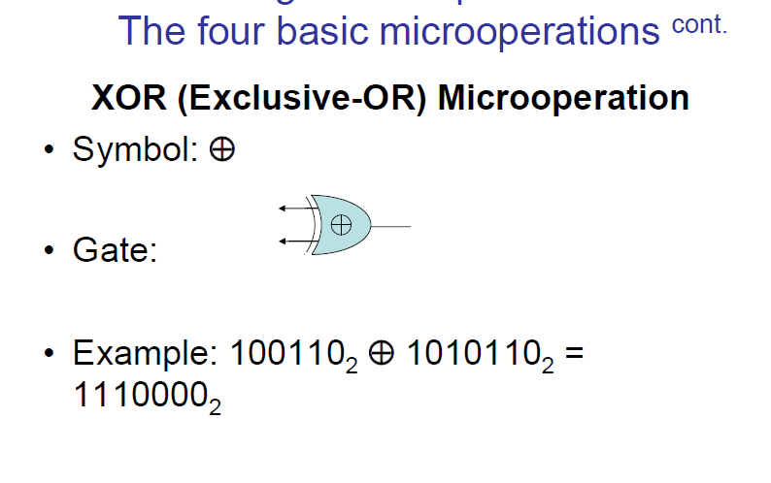
3-5 Logic Microoperations

Slide 30
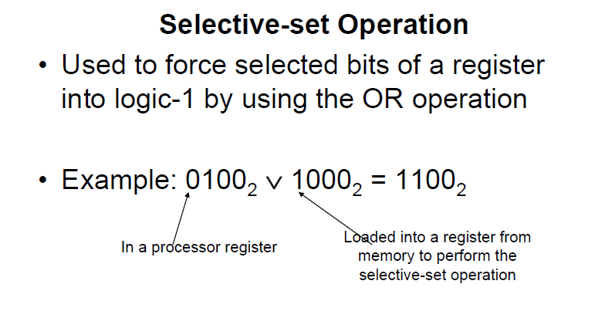
3-5 Logic Microoperations Other Logic Microoperations

Slide 31
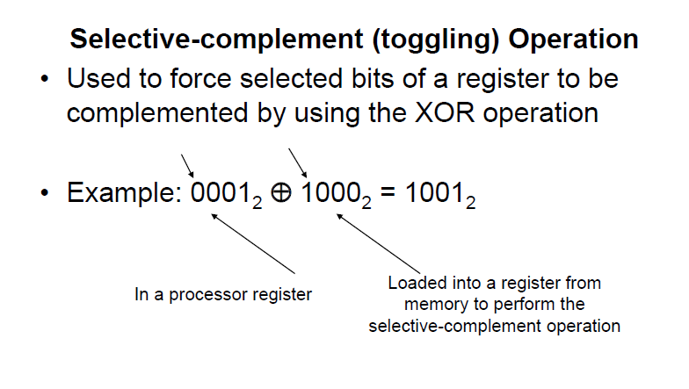
3-5 Logic Microoperations Other Logic Microoperations cont.

Slide 32
3-5 Logic MicrooperationsHardware Implementation
The hardware implementation of logic microoperations requires that logic gates be inserted for each bit or pair of bits in the registers to perform the required logic function
Most computers use only four (AND, OR, XOR, and NOT) from which all others can be derived.

Slide 33
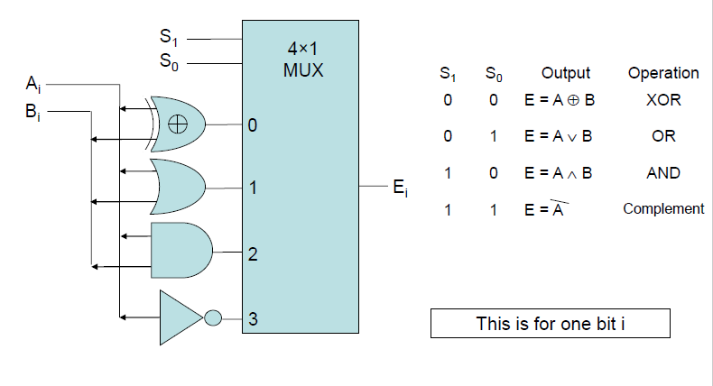
3-5 Logic MicrooperationsHardware Implementation cont.

Slide 34
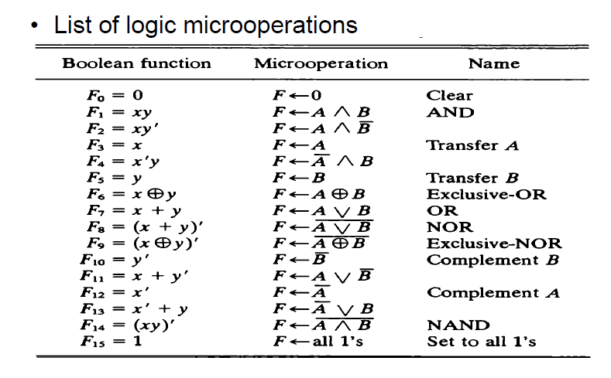
3-5 Logic Microoperations

Slide 35
3-6 Shift Microoperations
Used for serial transfer of data
Also used in conjunction with arithmetic, logic, and other data-processing operations
The contents of the register can be shifted to the left or to the right
As being shifted, the first flip-flop receives its binary information from the serial input
There are three types of shifts:
Logical shift,
Circular shift (rotate operation)
Arithmetic shift

Slide 36
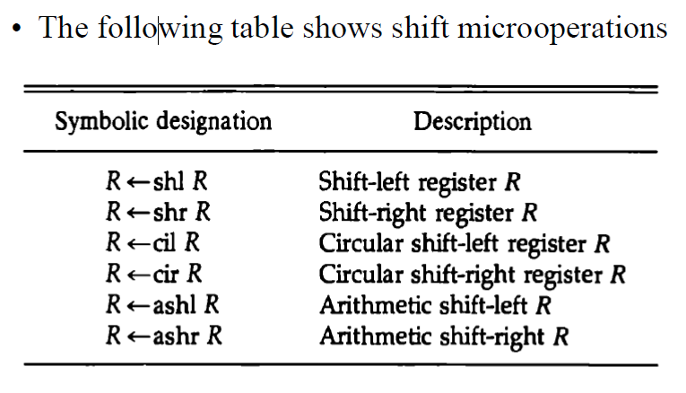
3-6 Shift Microoperations

Slide 37
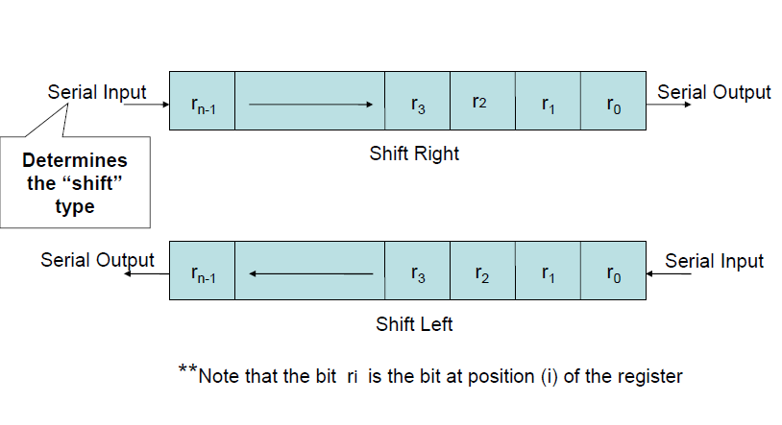
3-6 Shift Microoperations cont.

Slide 38
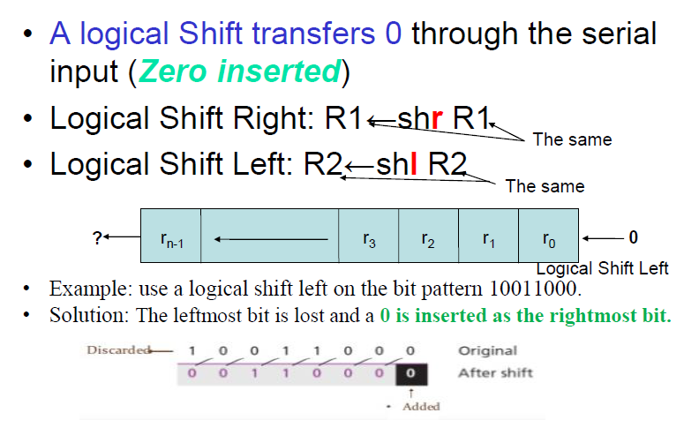
3-6 Shift Microoperations: Logical Shifts

Slide 39
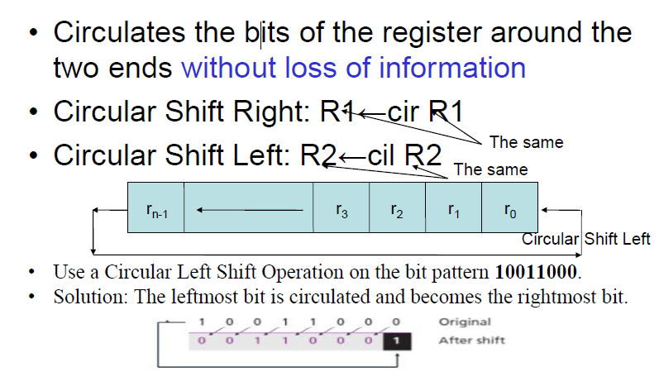
3-6 Shift Microoperations: Circular Shifts (Rotate Operation)

Slide 40
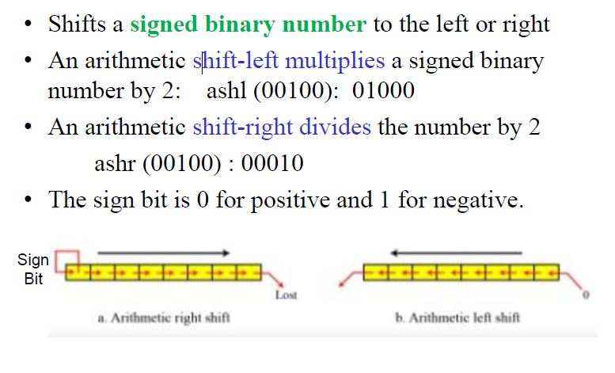
3-6 Shift MicrooperationsArithmetic Shifts

Slide 41
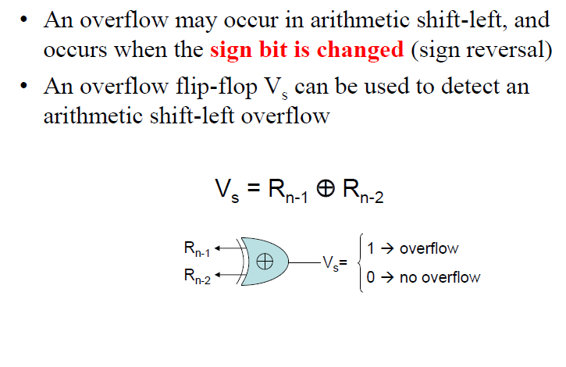
3-6 Shift Microoperations Arithmetic Shifts cont.

Slide 42
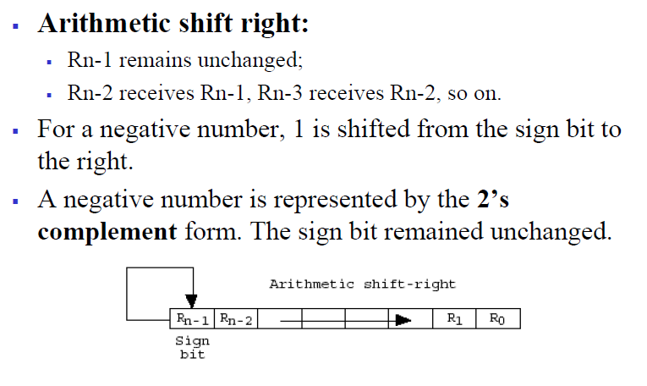
3-6 Shift Microoperations Arithmetic Shifts

Slide 43
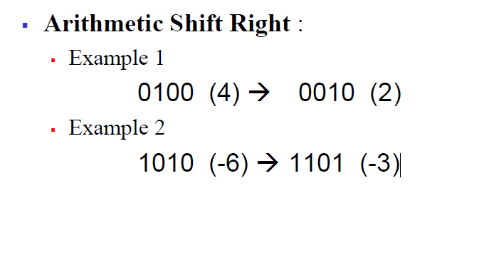
3-6 Shift Microoperations Arithmetic Shifts

Slide 44
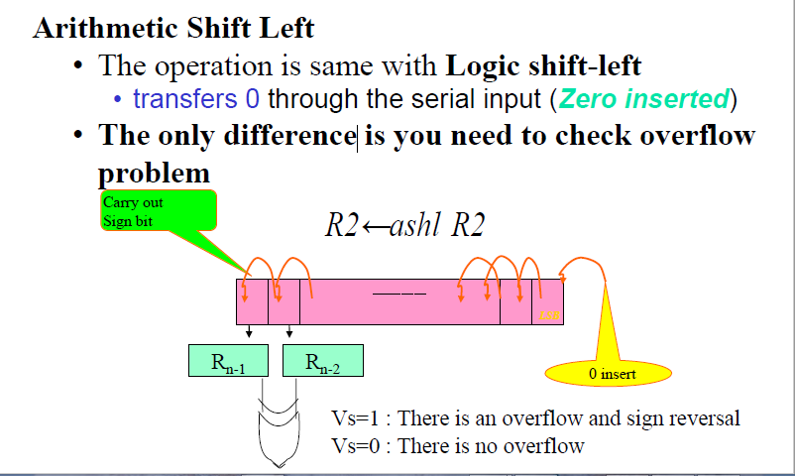
3-6 Shift Microoperations Arithmetic Shifts

Slide 45
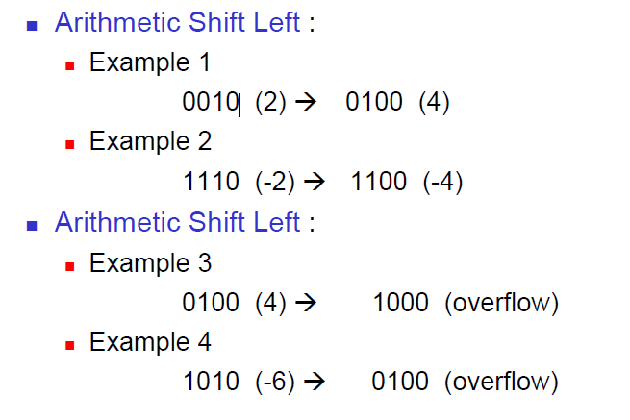
3-6 Shift Microoperations Arithmetic Shifts

Slide 46
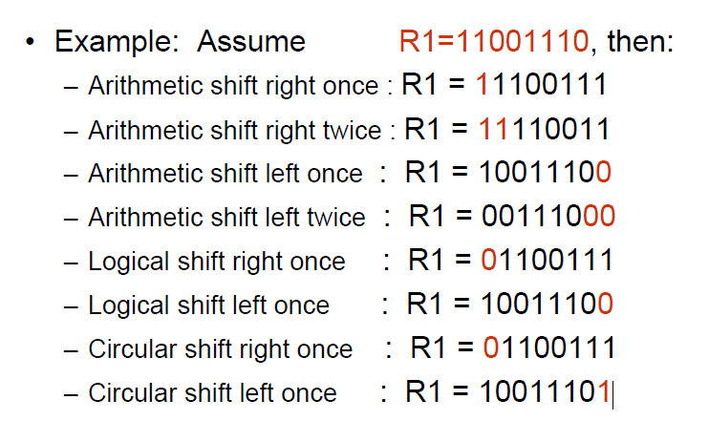
3-6 Shift Microoperations cont.

